Slide 1

What’s a Voicemail?
Gen Z at School and Work
HSLI 2022 September 7, 2022
Cynthia Ehret Snyder (she/her)
Academic Services Manager
Midwestern University
csnyde@midwestern.edu

Slide 2
Jean Twenge (2017) says those born between 1995 and 2012 (Gen Z, iGen) are distinct from every previous generation
• how they spend their time and how they behave
• attitudes toward religion, sexuality, and politics
• socialize in completely new ways
• reject once sacred social taboos
• want different things from their lives and careers
• obsessed with safety and fearful of their economic futures
• have no patience for inequality based on gender, race or sexual orientation
• suffering worst mental health crisis in decades

Slide 3
Attributes of Gen Z
“Slow life strategy”
Mental health
Communication

Slide 4
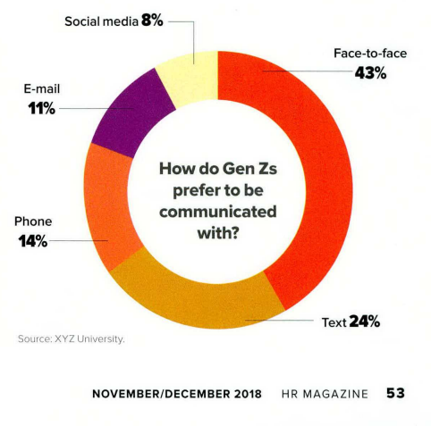
Communication
Janssen and Carradini (2021) “An always-on, always-available technology environment has dramatically changed the communication methods and expectations of young people, particularly those in Gen Z.”

Slide 5
Attributes of Gen Z
“Slow life strategy”
Mental health
Communication
Autonomous
Immediate gratification

Slide 6
Immediate gratification and information literacy
“It is imperative that educators bridge the gap between our current students’ lived experiences and their future professional environment.” (Lerchenfeldt et al., 2021)
Not just ‘click here’ but:
information management skills
critical thinking
determining credibility of sources
EBP skills

Slide 7
Attributes of Gen Z
“Slow life strategy”
Mental health
Communication
Autonomous
Immediate gratification
Prefer definition
Expect flexibility
Hyper-custom
Financially focused
Entrepreneurial
Diverse and socially progressive

Slide 8
Bibliography
Eckleberry-Hunt, J., Lick, D., & Hunt, R. (2018). Is Medical Education Ready for Generation Z? Journal of Graduate Medical Education, 10(4), 378–381. https://doi-org.mwu.idm.oclc.org/10.4300/JGME-D-18-00466.1
Ganguli R, Padhy SC, Saxena T. The Characteristics and Preferences of Gen Z: A Review of Multi-Geography Findings. IUP Journal of Organizational Behavior. 2022;21(2):79-98. Accessed August 12, 2022. https://search-ebscohost-com.mwu.idm.oclc.org/login.aspx?direct=true&AuthType=cookie,ip,uid&db=bsh&AN=157309311&site=ehost-live&scope=site
Janssen, D., & Carradini, S. (2021). Generation Z Workplace Communication Habits and Expectations. IEEE Transactions on Professional Communication, 64(2), 137–153. https://doi-org.mwu.idm.oclc.org/10.1109/TPC.2021.3069288
Johnson, D. B., & Sveen, L. W. (2020). Three Key Values of Generation Z: Equitably Serving the Next Generation of Students. College and University, 95(1), 37–40.
Lee, C. C., Aravamudhan, V., Roback, T., Hyoun Sook Lim, & Ruane, S. G. (2021). Factors Impacting Work Engagement of Gen Z Employees: A Regression Analysis. Journal of Leadership, Accountability & Ethics, 18(3), 147–159. https://doi-org.mwu.idm.oclc.org/10.33423/jlae.v18i3.4414
Lerchenfeldt, S., Attardi, S. M., Pratt, R. L., Sawarynski, K. E., & Taylor, T. A. H. (2021). Twelve tips for interfacing with the new generation of medical students: iGen. Medical Teacher, 43(11), 1249–1254. https://doi-org.mwu.idm.oclc.org/10.1080/0142159X.2020.1845305
Miller, J. (2018). 10 Things You Need to Know about Gen Z. HR Magazine, 63(7), 50–56.
Paggi, R., & Clowes, K. (2021). Managing Generation Z How to Recruit, Onboard, Develop, and Retain the Newest Generation in the Workplace. Quill Driver Books.
Plochocki, J. H. (2019). Several Ways Generation Z May Shape the Medical School Landscape. Journal of Medical Education and Curricular Development, 6, 2382120519884325. https://doi-org.mwu.idm.oclc.org/10.1177/2382120519884325
Riley, J., & Nicewicz, K. (2022). Connecting with Gen Z: Using Interactive Improv Games to Teach Soft Skills. Marketing Education Review, 32(2), 97–104. https://doi-org.mwu.idm.oclc.org/10.1080/10528008.2022.2041440
Schroth, H. (2019). Are You Ready for Gen Z in the Workplace? California Management Review, 61(3), 5–18. https://doi-org.mwu.idm.oclc.org/10.1177/0008125619841006
Schwieger, D., & Ladwig, C. (2018). Reaching and Retaining the Next Generation: Adapting to the Expectations of Gen Z in the Classroom. Information Systems Education Journal, 16(3), 45–54
Seemiller, C., & Grace, M. (2016). Generation Z goes to college. John Wiley & Sons.
Seibert, S. A. (2021). Problem-based learning: A strategy to foster generation Z’s critical thinking and perseverance. Teaching & Learning in Nursing, 16(1), 85–88. https://doi-org.mwu.idm.oclc.org/10.1016/j.teln.2020.09.002
Shatto, B. (2017). Teaching Millennials and Generation Z: Bridging the Generational Divide. Creative Nursing, 23(1), 24–28. https://doi-org.mwu.idm.oclc.org/10.1891/1078-4535.23.1.24
Smedstad, S., & LaMotte, S. (2022). In Their Shoes: How To Engage and Attract Gen Z? How today’s world is influencing career, job search, content, and channel preferences of students and recent grads. Talent Acquisition Excellence, 10(7), 26–29.
Stillman, D., & Stillman, J. (2017). Gen Z@ Work: How the next generation is transforming the workplace. HarperCollins.
Twenge, J. M. (2017). iGen: Why today's super-connected kids are growing up less rebellious, more tolerant, less happy--and completely unprepared for adulthood--and what that means for the rest of us. Simon and Schuster.

