Slide 1


eBooks
Excel in Learning
  Springer Nature eResources & New eBook Models

Slide 2
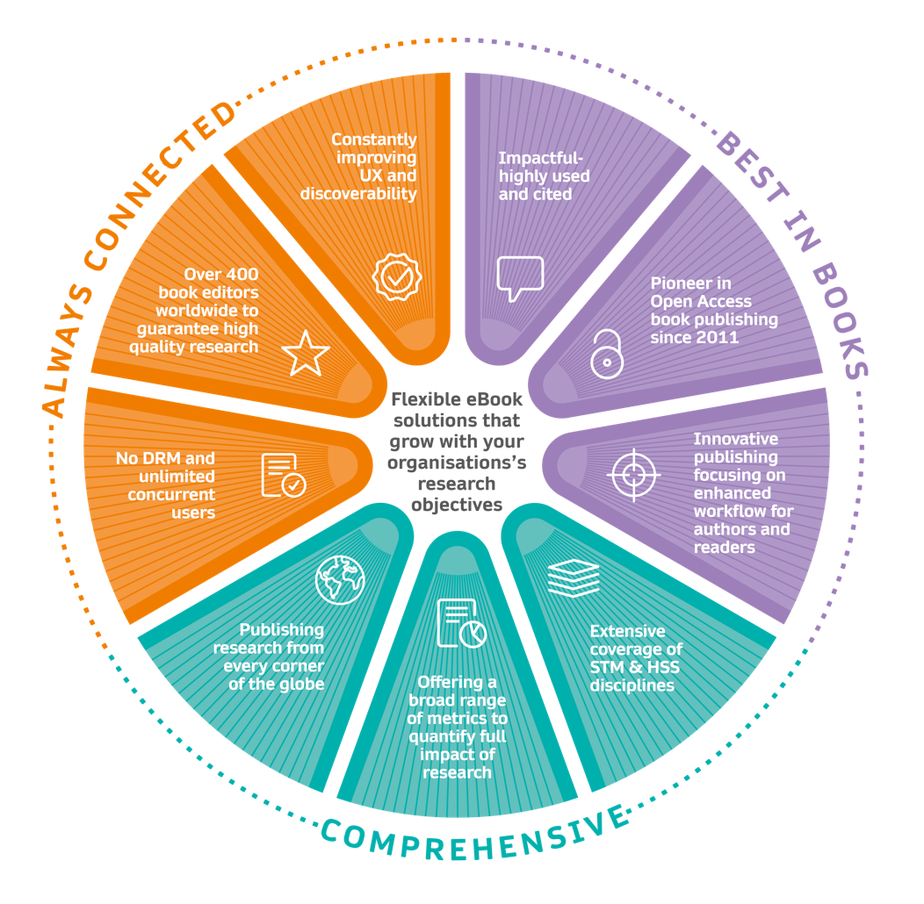
Springer Nature eBooks - Excel in Research & Learning
Best
Best In Books
Most downloads and most citations per year across all library publishers
Leader in Open Access
Comprehensive
400 Acquisitions Editors
Always Connected
Constant improvements to UX and Discoverability

Slide 3

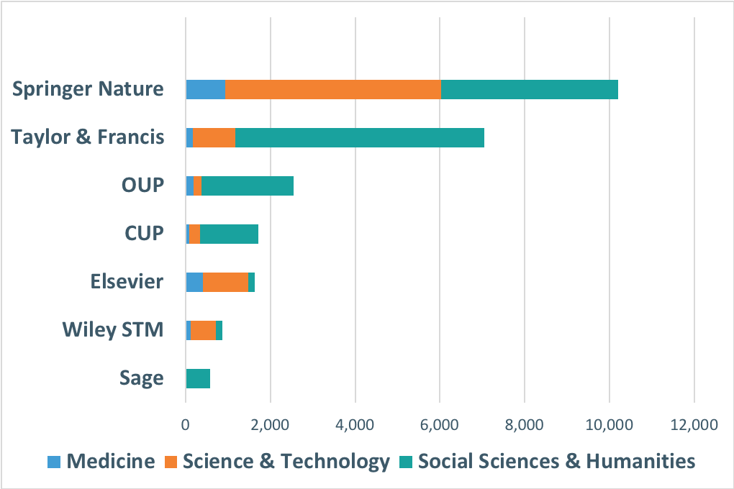
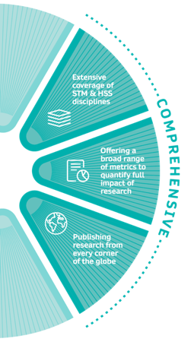
Largest scholarly book publisher in the world
Extensive
coverage of STM
HSS disciplines
Over
10,000+
English titles per year
2018 data from www.puballey.com; only books available through YBP approval plans; if a book is published simultaneously in hard- and paperback editions, only the hardback edition was included

Slide 4
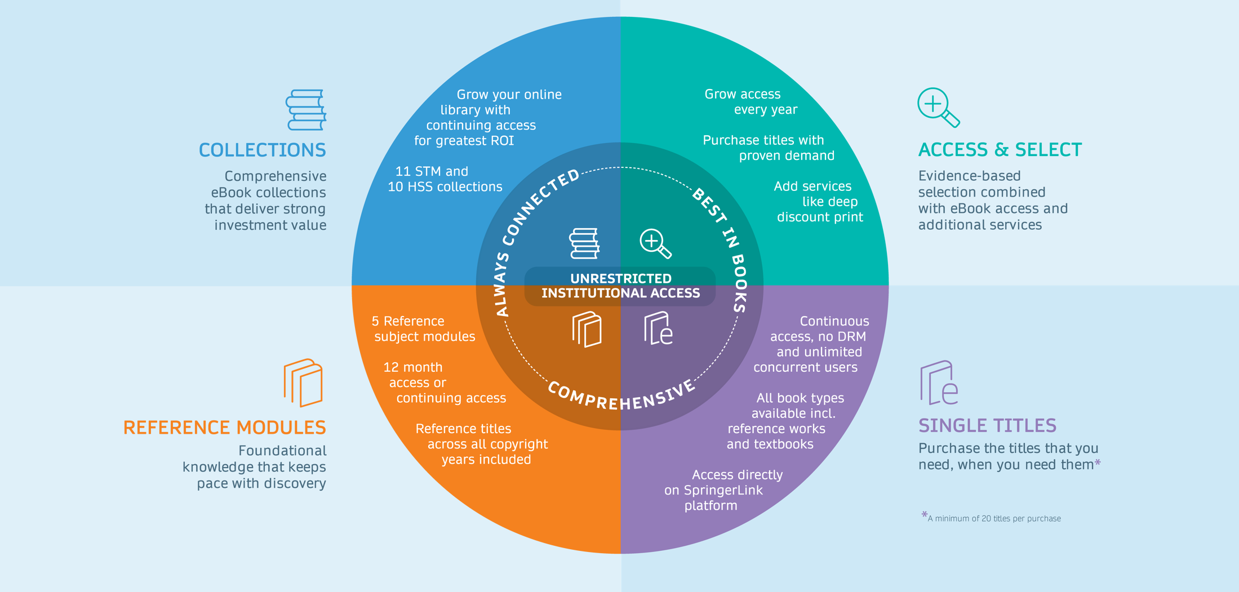
Flexible eBook Solutions
That grow with your organization’s research objectives
Notes:
Sacha we need an updated graphic that says Reference Modules

Slide 5

Collections
Comprehensive eBook collections that deliver strong investment value
Grow your online
library with
continuing access
for greatest ROI
Science, Technology and Medicine:
Humanities and Social Sciences:
Biomedical & Life Science |  | Behavioural Science & Psychology
Chemistry & Materials Science |  | Business & Management
Computer Science |  | Economics & Finance
Earth & Environmental Science |  | Education
Energy |  | History
Engineering |  | Literature, Cultural & Media Studies
Intelligent Technologies & Robotics |  | Political Science & International Studies
Mathematics |  | Philosophy & Religion
Medicine |  | Social Sciences
Physics & Astronomy |  | Law & Criminology
Professional & Applied Computing

Slide 6
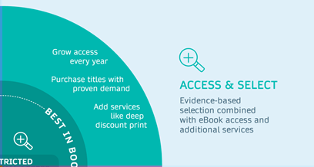
Access & Select
Grow your access every year
  Access starts at first year of contract + 3 previous copyright years and grows every year with renewal
License the titles with proven demand
  We credit your account with your upfront access spend for you to purchase books in perpetuity at the end of the access period
  Reference Works not included in this program
Add additional services, like
  My Copy, Inter Library Loan, Deep Discount Print
Evidence based selection combined with access and additional services

Slide 7







Access & Select
Evidence based selection combined with access and additional services
 |  | Basic |  | Plus |  | Smart |  | Premium
Access to Disciplines |  | selected subject collections
Access to copyright years |  | 4 © years rolling |  | Since contract year + 3 previous years |  | Since contract year + 3 previous years |  | Since contract year + 3 previous years
Vouchers for ind. eBooks* (in % of spend) |  | 100% |  |  |  | 100% |  | 120%
MyCopy possibility
Full Book ILL
Deep Discount Print

Slide 8





Reference Modules
Foundational knowledge that keeps pace with discovery
Subject Reference Modules
12 month or continuing access
Reference titles across all copyright years included
Biomedical
& Life Science
Medicine
Humanities, Social
Science & Law
Computer Science, Engineering
& Mathematics
Physics &
Materials Science

Slide 9
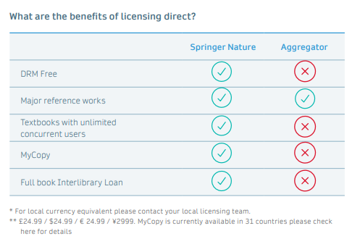
Title-by-Title
License titles you need, when you need them
Freedom to license only the titles that your institution needs
Minimum of 20 titles, or $5,600 (whichever comes first)
Average Institutional eBook Price: $280.00
All book types available including reference works and textbooks
Includes continuous access, no DRM and unlimited
Previously only available via aggregators or as a personal copy for individuals

Slide 10

Thank you
Alan Bayert
Licensing Manager
Alan.Bayert@springernature.com
eBooks

