Slide 1
Doody’s Special Topics Lists The Intersection of Public Health and Curated Book Lists
Doody Enterprises, Inc.
Tim Butzen-Cahill, MLIS
HSLI Annual Conference
October 2021

Slide 2
Different lenses through which to examine “public health”
Geographic location
Economic factors
Social factors
Psychological factors
Time

Slide 3
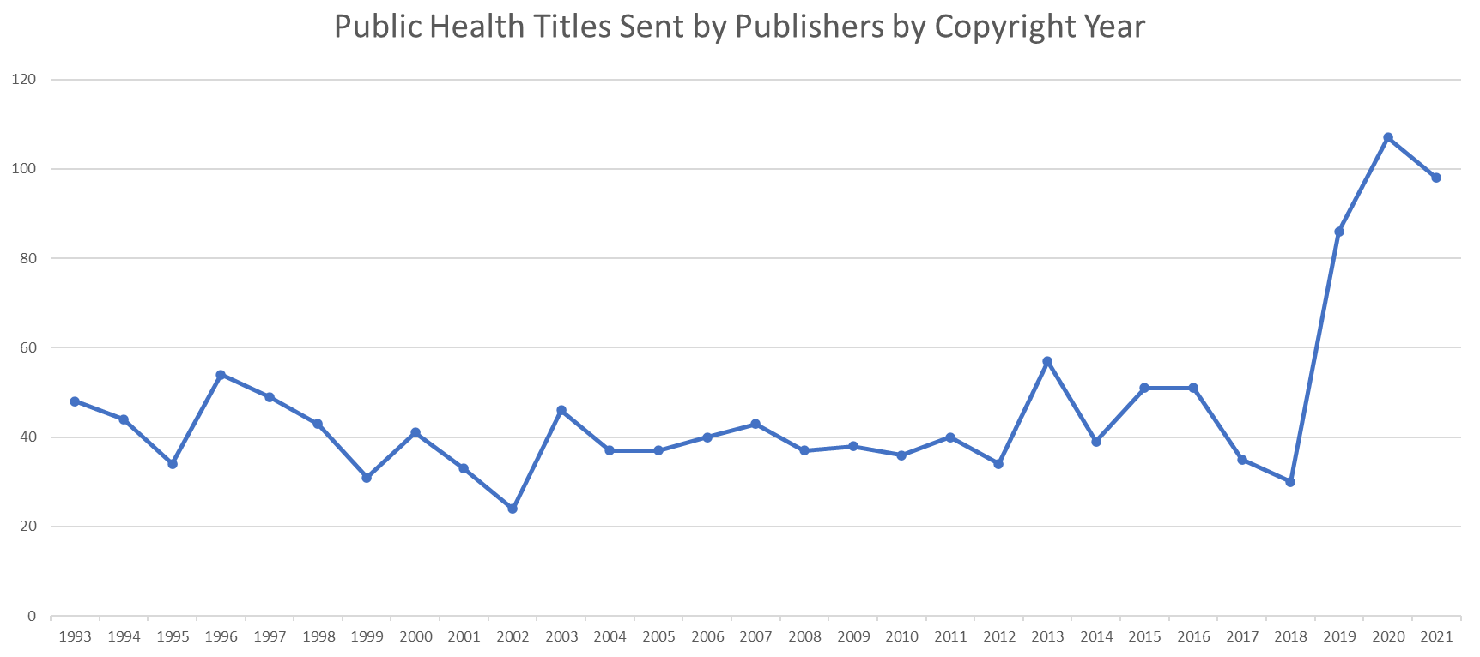

Slide 4
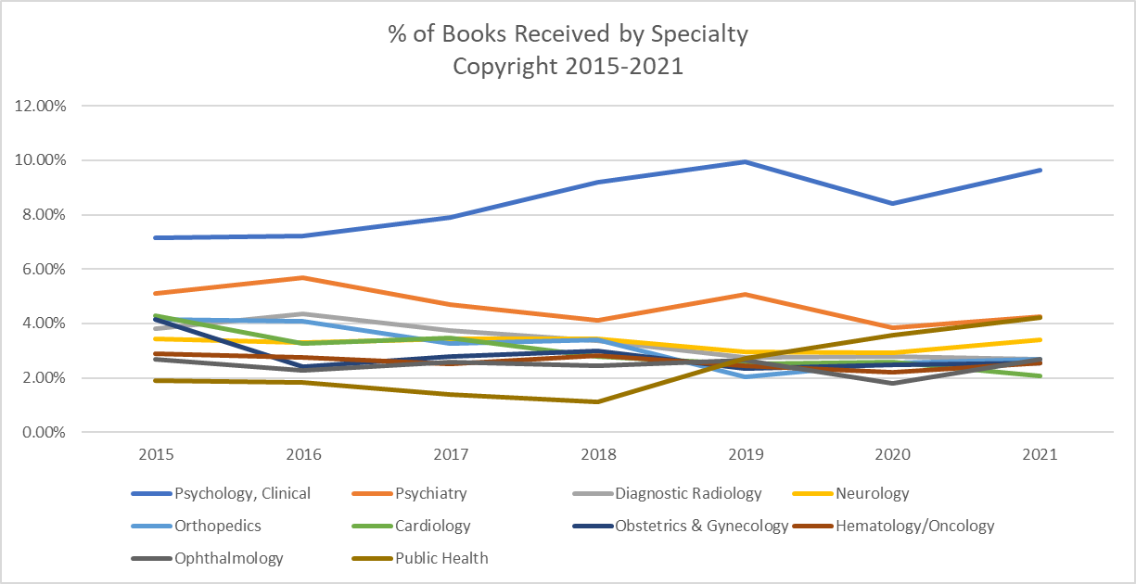

Slide 5
Collections response to public health priorities
Acquire or centralize resources that respond to the actual or anticipated information needs of those who respond to or are affected by public health priorities
Take an interdisciplinary approach to aggregating resources
March 2020: COVID-19 Book List

Slide 6
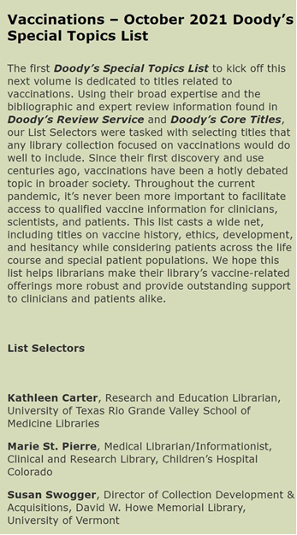
…and thus, Doody’s Special Topics Lists!
Quarterly book lists
High-impact, interdisciplinary topics
Curated by seasoned librarians
Overseen by Editorial Board

Slide 7
Where we’ve been…
Oct. 2020
Health Equity
Jan. 2021
Telehealth
Apr. 2021
Health Professionals & Stress
July 2021
Health Literacy
Oct. 2021
Vaccinations

Slide 8
…and where we’re going next!
Jan. 2022
Rural Health
Apr. 2022
Health Insurance & the Cost of Health Care
July 2022
Climate Change & Its Effects on Health

Slide 9
How to access the lists
Doody’s Core Titles
Doody’s Review Service
Licensing partners
Ovid
Rittenhouse
Matthews
EBSCO
Login Canada
Not sure? Contact Doody’s customer service: csr@doody.com

Slide 10
Questions? Ideas for future lists?
Thank you!

