Slide 1
Complementary, Alternative and Integrative Medicine (CAIM) and the Evidence Base
HSLI Annual Meeting
October 2021
Peg Burnette Associate Professor and Medical & Biomedicine Librarian University of Illinois at Urbana, Champaign

Slide 2
About me...
Associate Professor, University Library and Carle Illinois College of Medicine AND Medical & Biomedicine Librarian
Subject liaison for…
UI Carle Illinois College of Medicine (CI Med)
Interdisciplinary Health Sciences Institute (IHSI)
Curriculum development
Teaching
Research support & consultation
Collection development
Subject expertise…
Medical education
Evidence-based Practice
Biomedical Research
Research areas…
Medical informatics and medical education
Knowledge management & Tacit knowledge
Notes:
Biochemistry  Bioinformatics  Biomedical Engineering  Cancer  Cell Biology  Genetics  Immunology  Neuroscience  Physiology  Translational Research

Slide 3
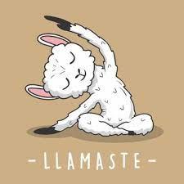
Disclaimer and Disclosure
The content of this session is for informational purposes only and is not intended to replace consultation with one’s health care provider(s).
I neither recommend nor endorse the use of any of the products or methods discussed.
I have no investments related to the products or methods.
I do not personally take any dietary or herbal supplements.
I do occasionally practice yoga – that’s it!
https://www.freepik.com/premium-vector/llama-yoga-cartoon-cute-alpaca-meditation-llamaste_6974099.htm

Slide 4
Today’s Outline
About CAIM
Evidence for CAIM
Case Studies
Wrap-up

Slide 5
About Complementary, Alternative and Integrative Medicine (CAIM)

Slide 6
Considers patient values, beliefs and circumstances
CAIM Definitions
Alternative medicine non-mainstream practice used in place of conventional medicine
Complementary medicine
non-mainstream practice used in conjunction with conventional medicine
Integrative medicine holistic approach that combines conventional and complementary approaches to treat the whole person
Conventional
Medicine
Conventional
Medicine
Conventional
Medicine
Adapted from: MedEdPORTAL December 2020 Implementing an Interactive Introduction to Complementary Medicine for Chronic Pain Management Into the Medical School Curriculum Uttara Gadde et al. https://doi.org/10.15766/mep_2374-8265.11056

Slide 7
CAIM in the literature
“Alternative Medicine”
11,833 results back to 1967
1995
1995
“Complementary Medicine” 6,037 results back to 1981

Slide 8
CAIM in the literature
“Integrative Medicine”
12,527 results back to 1951 (Chinese)
2000

Slide 9
CAIM-related disciplines
Holistic Medicine
views a patient as a whole person, not as just a disease or a collection of symptoms
Homeopathy
employs Law of Similars where "like cures like“ - treatment using highly diluted substances that cause the disease in healthy persons
Naturopathy
emphasizes the curative power of nature - uses diet and nutrition but no drugs
Cochrane Complementary Medicine Glossary of CAM terms

Slide 10
MeSH
Mind-Body Therapies
Aromatherapy
Biofeedback, Psychology +
Breathing Exercises +
Hypnosis +
Imagery, Psychotherapy
Laughter Therapy
Meditation
Mental Healing
Psychodrama +
Psychophysiology
Relaxation Therapy
Tai Ji
Therapeutic Touch
Yoga
Therapeutics
Complementary Therapies
Acupuncture Therapy+
Anthroposophy
Auriculotherapy+
Cupping Therapy
Diffuse Noxious Inhibitory Control
Dry Needling
Holistic Health+
Homeopathy
Horticultural Therapy
Integrative Oncology
Medicine, Traditional+
Mesotherapy
Mind-Body Therapies+
Musculoskeletal Manipulations+
Naturopathy
Organotherapy+
Phytotherapy+
Prolotherapy
Reflexotherapy
Musculoskeletal Manipulations
Kinesiology, Applied
Manipulation, Orthopedic
Manipulation, Osteopathic
Manipulation, Spinal
Motion Therapy, Continuous Passive
Therapy, Soft Tissue
Acupressure
Massage +

Slide 11
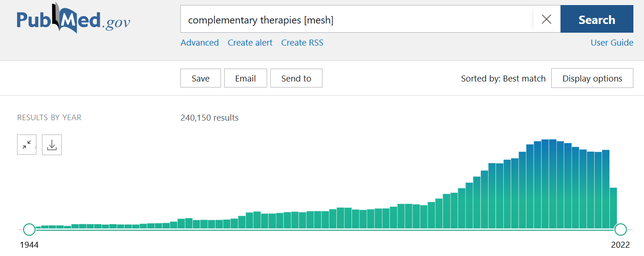
Introduced 2002
2002

Slide 12
Why Interest in CAIM?
Wellness & Prevention
Other Factors
Improve overall physical and mental health
Enhance wellbeing
Prevent or slow worsening of chronic conditions
Therapy
Pain Relief*
Relief for chronic conditions
Self-care
“Natural”
No prescription needed
Mistrust of mainstream medicine
Desperation or last resort

Slide 13
Common Mind/Body Interventions
Mind Body
Meditation
Mindfulness
Art/Music therapies
Relaxation therapies
Pet Therapy
Tai chi
Yoga
Dance
This Photo by Unknown Author is licensed under CC BY-SA-NC
Notes:
Contributes to wellness AND healing

Slide 14
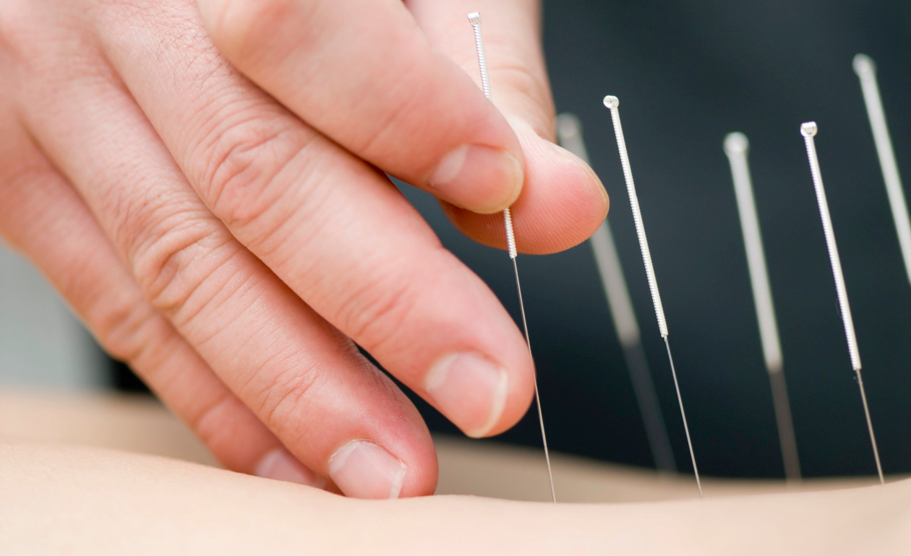
Common Manipulation Interventions
Manipulation
Acupuncture
Massage therapy
Spinal manipulation (Chiropractic)
This Photo by Unknown Author is licensed under CC BY-NC-ND
Notes:
Contributes to wellness AND healing

Slide 15
Ancient practices
Native American Medicine
Life-force is critical element to healing
Emphasizes spirits of patient, healer, patient’s family, community, environment and medicine
Traditional Chinese Medicine (TCM)
Incorporates the concept of a vital life force energy (qi) involved in balancing a person’s spiritual, emotional, physical, and mental state.
Ayurveda
5000-year-old medical practice of India that focuses on prevention and treatment
Mind, body, spirit connection
Nutrition, herbals, exercise, meditation and yoga

Slide 16
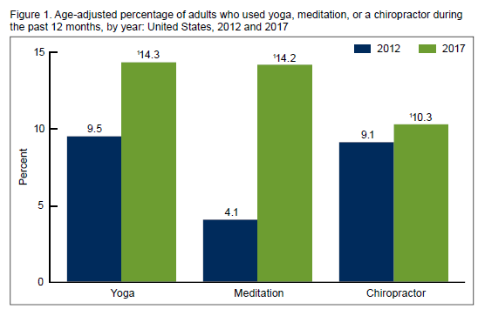
2017 National Health Interview Survey (NHIS) Adults
Yoga was the most used CAIM approach; highest use was among adults 18 to 44 compared to older adults.
Meditation increased more than threefold from 2012 to 2017; use was higher among adults 45 to 64 years compared with younger and older age groups.
NCHS Data Brief. 2018 Nov;(325):1-8.

Slide 17
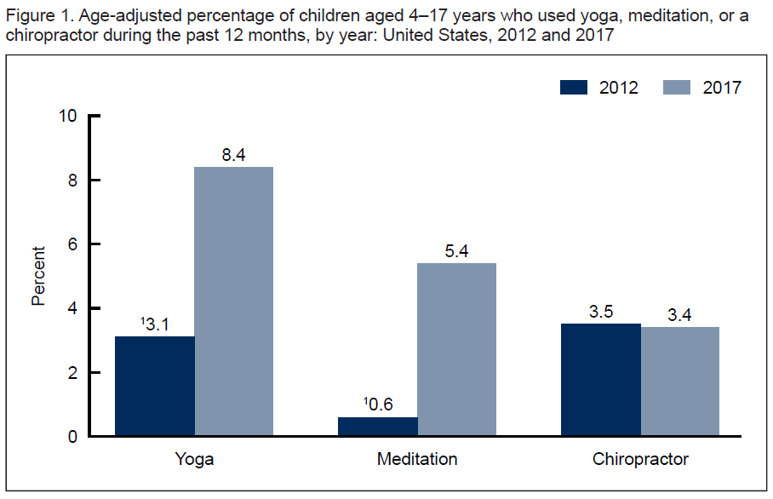
2017 National Health Interview Survey (NHIS) Children
Yoga - Girls (11.3%) were much more likely to use than boys (5.6%)
Meditation - Higher use among older children ages 12 – 17
NCHS Data Brief. 2018 Nov;(324):1-8.

Slide 18
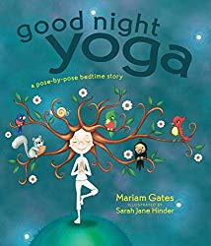
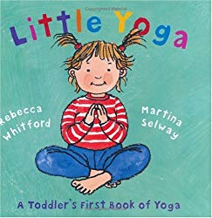
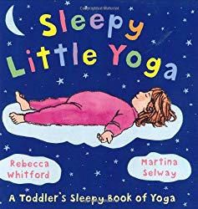

Slide 19
Credentials, Licensure, Certification
No national standards for credentialing complementary health practitioners
Varies widely state by state and discipline by discipline
Mandatory licensure – license required for service
Title licensure – credentials are required for certain titles
Registration – practitioners must proof of training and experience
Qualifications
Graduation from approved program
Certification from national organization
Completion of specific training requirements
Exam for licensure

Slide 20
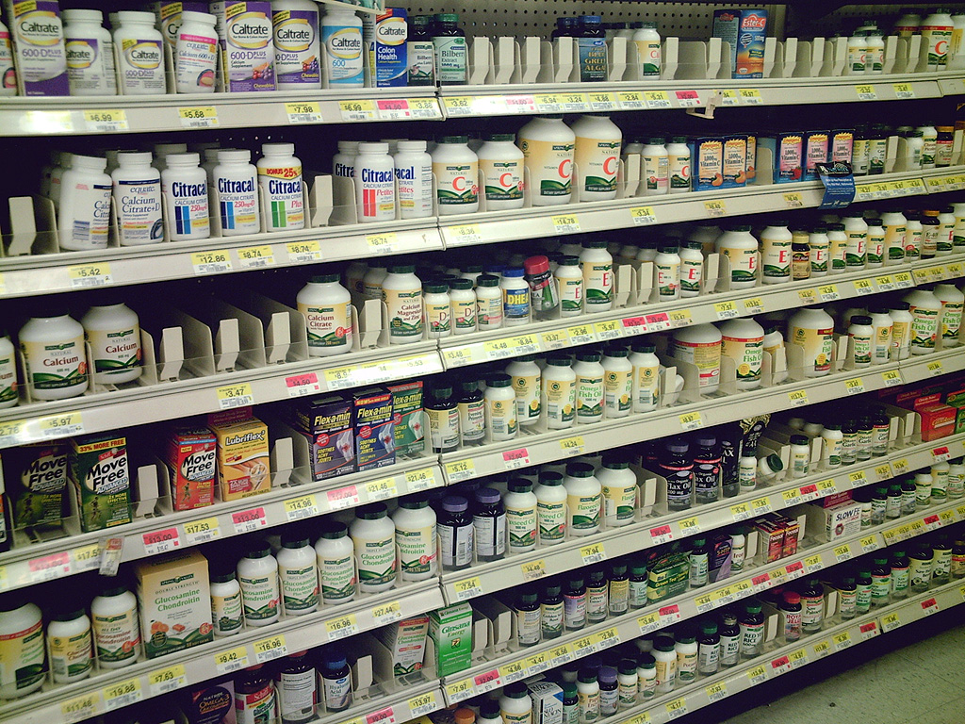
Common Diet & Nutrition Interventions
Diet & Nutrition
Herbs
Vitamins & minerals
Ergogenic aids
Other “dietary supplements”
This Photo by Unknown Author is licensed under CC BY
Notes:
Contributes to wellness AND healing

Slide 21
Commonly used herbal supplements (US)
Saw Palmetto – prostate cancer
Garlic - hypertension
Gingko Biloba – memory & cognition
Echinacea – colds, flu, respiratory infections
Black Cohosh – PMS and menopausal symptoms
Ginseng – physical and mental performance; energy and immunity
Hawthorn – angina and other heart issues
St. John's Wort – mild to moderate depression
Goldenseal – colds, flu, antiseptic
Feverfew – migraine, menstrual cramps
StatPears - Herbal Supplements
Shabi Furhad; Abdullah A. Bokhari. April 20, 2021

Slide 22
Regulation
Dietary supplements (DS) are regulated under the Dietary Supplement Health and Education Act (DSHEA) of 1994
DS must be manufactured free of contaminants or adulterants
The DS manufacturers are responsible for evaluating the safety and labeling of their products
US Pharmacist – Determining the Quality of Dietary Supplements

Slide 23
FDA...
established good manufacturing practices (GMPs) that companies must follow to help ensure the identity, purity, strength, and composition of DS
requires that DS must be labeled with the term dietary/herbal supplement OR with the ingredient, such as calcium supplement
does not require DS are proven safe before they are marketed
does not require proof from the manufacturer or seller that claim is accurate before it appears on the product
does not approve prior to market, but monitors after product hits market
firms must report any serious adverse events to the FDA
will act only when a product is found to be adulterated or misbranded once it has already reached the market
FDA 101 – Dietary Supplements

Slide 24
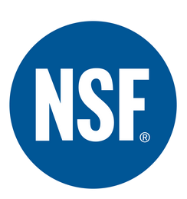
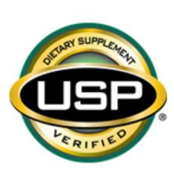
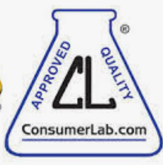
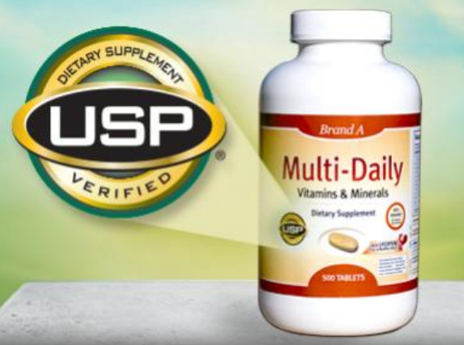
Third-party certification
Independent organizations offer testing for quality; products that pass these tests can display a seal of quality assurance that indicates the product was properly manufactured, contains the ingredients listed on the label, and does not contain harmful levels of contaminants.
NSF International (NSF)
United States Pharmacopeia (USP)
ConsumerLab.com (CL)
NSF and USP are not-for-profit organizations

Slide 25
US vs. Canada
U.S. - dietary supplements are regulated as a food category
Canada - dietary supplements or “Natural Health Products” (NHPs) are treated as non-prescription drugs
NHPs must be safe to use as over-the-counter (OTC) products and do not need a prescription
Natural Products Insider – Regulatory

Slide 26
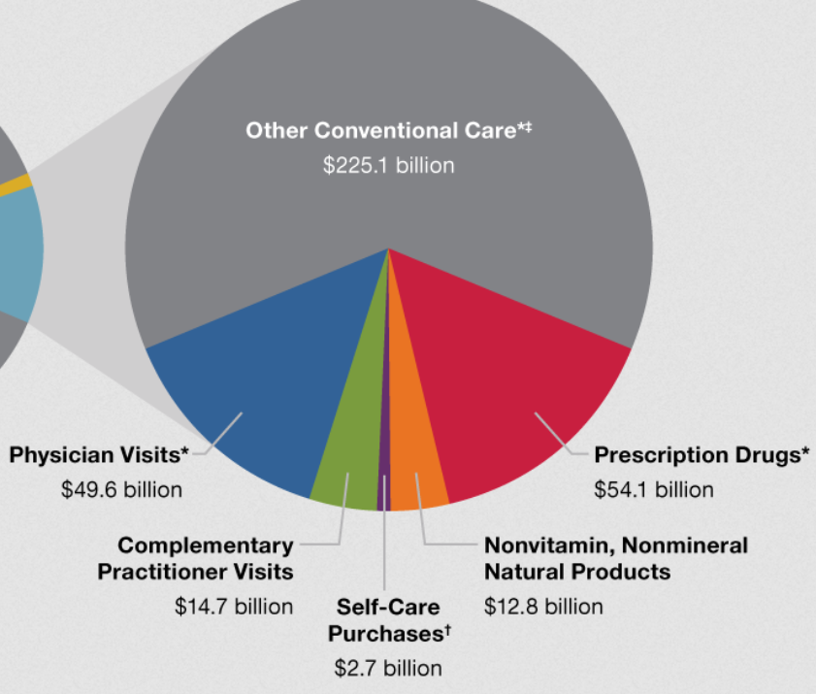
$30.2 Billion Out-Of-Pocket
Consumer Spending
14.7 billion out of pocket for chiropractors, acupuncturists or massage therapists
12.8 billion out-of-pocket for natural products
NCCIH 2016 https://www.nccih.nih.gov/news/press-releases/americans-spent-302-billion-outofpocket-on-complementary-health-approaches

Slide 27
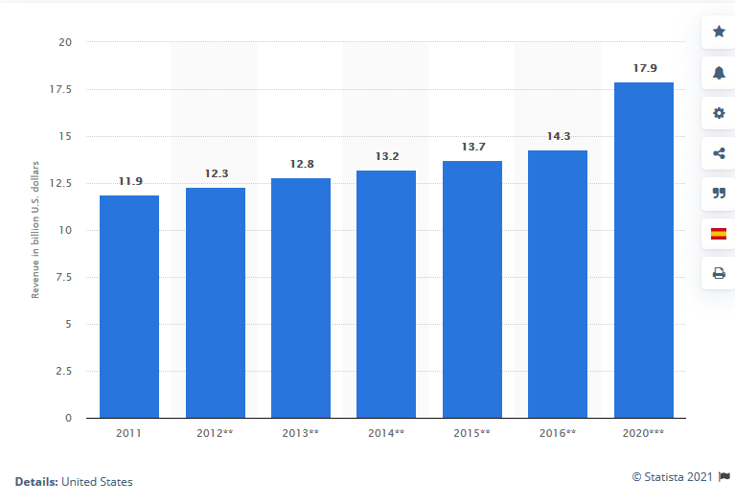
Industry Revenue
Estimated alternative medicine industry revenue in the U.S.
almost 18 billion for 2020
IBISWorld. (April 29, 2020). Estimated alternative medicine industry revenue in the U.S. from 2011 to 2020* (in billion U.S. dollars) [Graph]. In Statista. Retrieved October 20, 2021, from https://www.statista.com/statistics/203972/alternative-medicine-revenue-growth/

Slide 28
Insurance coverage
Many major health insurers cover some of the cost of alternative therapies
91% cover chiropractic care
32% cover acupuncture
17% cover massage therapy
Other modalities (tai chi, yoga, etc.) are unlikely to be covered
https://nccih.nih.gov/health/financial
https://quotewizard.com/health-insurance/complementary-and-alternative-medicine-and-health-insurance
Notes:
-Americans spend billions of dollars out of pocket to pay for CAM modalities.
-Some modalities such as acupuncture can be covered by some insurance plans, but others (such as tai chi or yoga) are very unlikely to be covered by insurance.

Slide 29
Challenges
Providers...
Services are becoming more mainstream
Patients don’t disclose use
Risk of interactions with other drugs
Lack of evidence
Lack of regulation and oversight
Anyone...
Lack of quality control
Ingredients
Potency
Stability
Contaminants
Risks
Individuals respond differently
Lack of pre-market testing
Supplements can increase or decrease a drug’s effects

Slide 30
Misinformation & Disinformation
Testimonials as “evidence”
Excessive claims
Miracle cures
News stories often fail to:
Compare one therapy versus another
Discuss side effects
Disclose whether study results are statistically significant (not chance)
Animal vs. people

Slide 31
Your turn...
What about Wormwood as therapy for Covid-19?
First name....A - L
This herb used to make absinthe will not cure your COVID-19
https://bangordailynews.com/2021/09/08/homestead/this-herb-used-to-make-absinthe-will-not-cure-your-covid-19/ First name...M - Z
Artemisia and Artemisia-based products for COVID-19 management: current state and future perspective
https://www.ncbi.nlm.nih.gov/pmc/articles/PMC8098784/

Slide 32
5 minutes...
Is Wormwood safe?
Is Wormwood effective?
Would you recommend taking Wormwood?
Other thoughts or comments?

Slide 33
Evidence for CAIM

Slide 34
Research challenges in CAIM
Lack of robust research methods for CAIM interventions
Lack of acceptable placebos for RCTs
Dosage and administration are not well established
Ethical concerns
sham invasive procedures, withholding potential proven treatments, or deception
Lack of funding
Lack of research for integrated therapeutic modalities
Publication bias favors conventional research

Slide 35
Placebo and CAIM
Can produce false benefit
Can reflect classical conditioning or fulfillment of expectations
Outcomes – self-rated effect vs. pathophysiology
Lack of research/understanding about mind body interactions
Placebo Effect. StatPearls. https://www.ncbi.nlm.nih.gov/books/NBK513296/

Slide 36
Evidence for CAIM
ASSESS the patient or problem
ASK questions
ACQUIRE the best available evidence
APPRAISE the evidence for quality, validity and applicability
APPLY the evidence if appropriate for this person or problem
Best decision
Notes:
I think we could almost stop here, and then

Slide 37
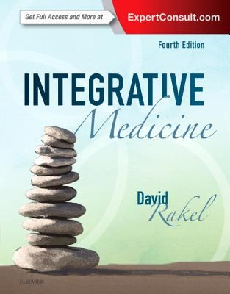
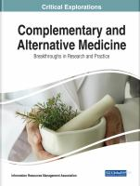
Types of Evidence for CAIM
Secondary
Books
Clinical Collections
PubMed for
Systematic Reviews & Meta-Analyses
Primary
PubMed
RCTs
Cohort Studies
“Expert opinion” from Government
National Center for Complementary and Integrative Health (NCCIH)
Office of Dietary Supplements (NIH)
U.S. Food and Drug Administration (FDA)
Food and Nutrition Information Center (FNIC)
MedlinePlus.gov

Slide 38
Approaches to finding evidence
Condition or Health Issue – explore CAIM options
Nutritional
Mind-Body
Specific Mind/Body
What is it used for?
What studies have been done and what do they show?
Is trained professional required?
Specific Herbal/Dietary Supplement
What is it used for?
What about safety and efficacy?
What studies have been done and what do they show?

Slide 39
Case study – Mind/Body
Eliza, a middle-aged professional violin player, visits her primary care provider for chronic neck pain
She is reluctant to take OTC pain meds
A friend swears by the Alexander Technique and wants to know if this would be worth trying

Slide 40
What do we need to know?
General information about the Alexander Technique and what is it used for
Explore alternative therapies for chronic neck pain
Let’s start with a clinical collection - DynaMed

Slide 41
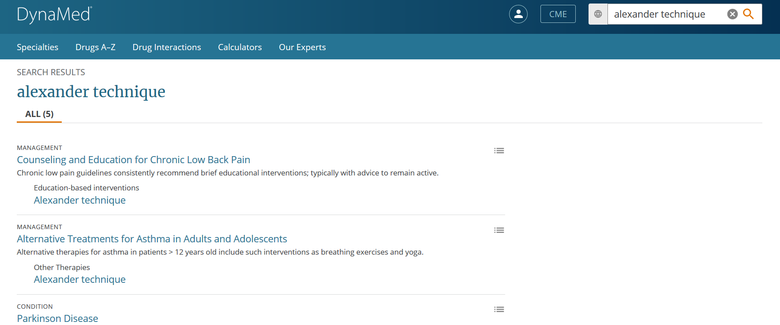

Slide 42
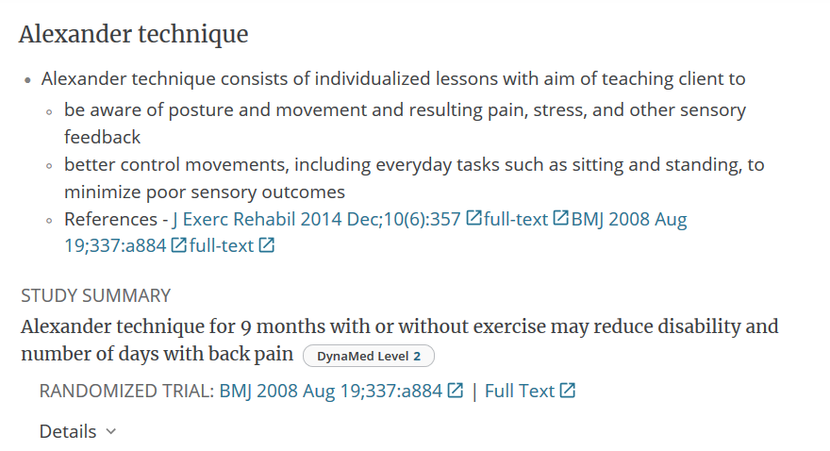

Slide 43
Dig deeper in PubMed...
“alexander technique” AND chronic pain
chronic neck pain AND complementary therapies
limit to SRs, RCTs, 10 years

Slide 44
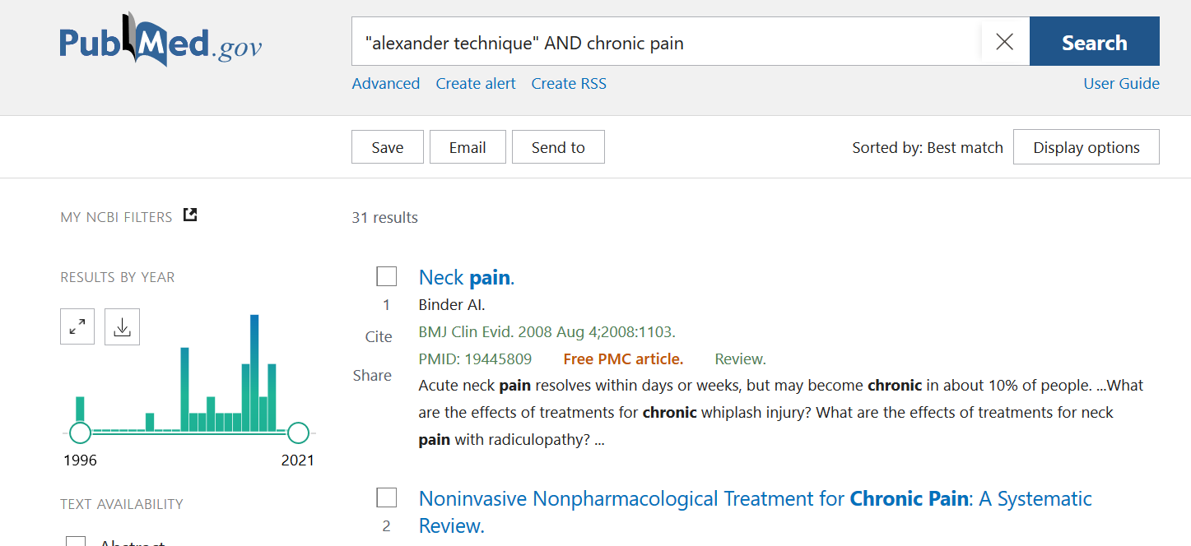

Slide 45
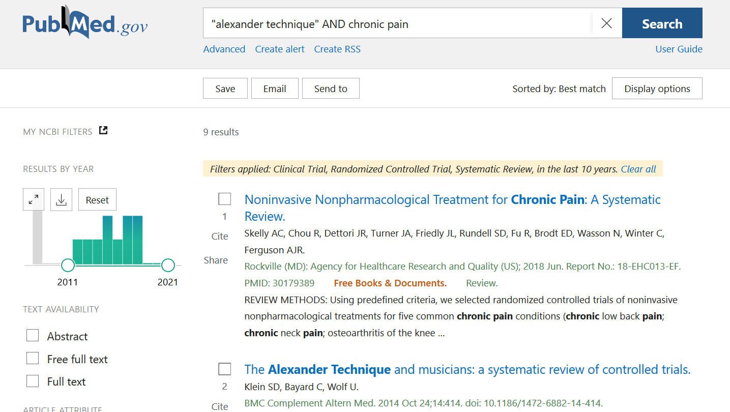

Slide 46
Results
(SR 2014) Evidence from RCTs and CTs suggests that AT sessions may improve performance anxiety in musicians. Effects on music performance, respiratory function and posture yet remain inconclusive.
(2018 SR) At short and intermediate terms, acupuncture and Alexander Technique were associated with slightly improved function compared with usual care but no improvement in pain was seen at any time
(RCT 2015) Acupuncture sessions and Alexander Technique lessons both led to significant reductions in neck pain and associated disability compared with usual care at 12 months.
(RCT 2016) The Alexander Technique was not superior to local heat application in treating chronic non-specific neck pain. It cannot be recommended as routine intervention at this time.
(RCT 2017) In comparison with usual care, acupuncture is likely to be cost-effective for chronic neck pain, whereas, largely due to higher intervention costs, Alexander lessons are unlikely to be cost-effective. However, there were high levels of missing data and further research is needed

Slide 47
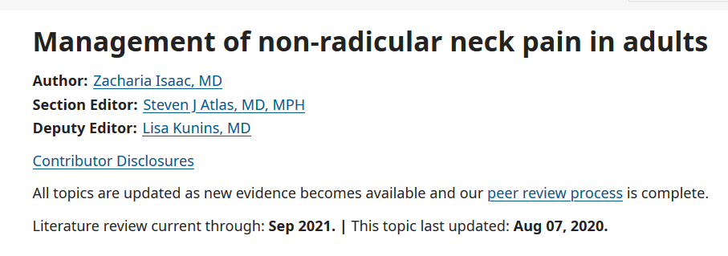
Non-pharmacologic therapy for chronic neck pain - UpToDate
Tai Chi
Yoga
Manipulation
Chiropractic
Osteopathic
Physical therapy
Massage therapy
Acupuncture

Slide 48
Case Study – herbal supplement
Hogarth is a 26 year old botanist who has been diagnosed with mild depression.
Reluctant to take prescribed medication (SSRI) he prefers to try alternative medicines which he feels are better for the body and work just as well.
He had read about St. John’s Wort and wonders if that is an option.

Slide 49
What do you need to know?
What are non-pharmaceutical options for treating mild depression?
Mind/Body
Nutritional
Efficacy & effectiveness
Safety (Is this patient on other meds? Check for interactions)

Slide 51
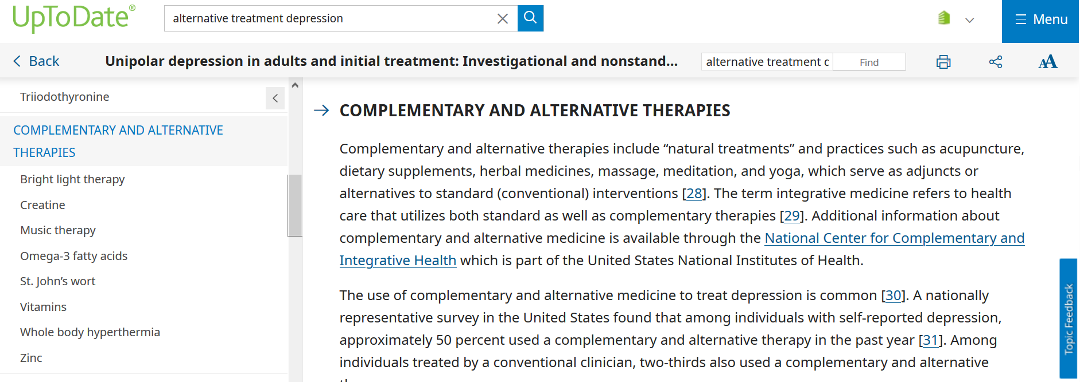

Slide 52
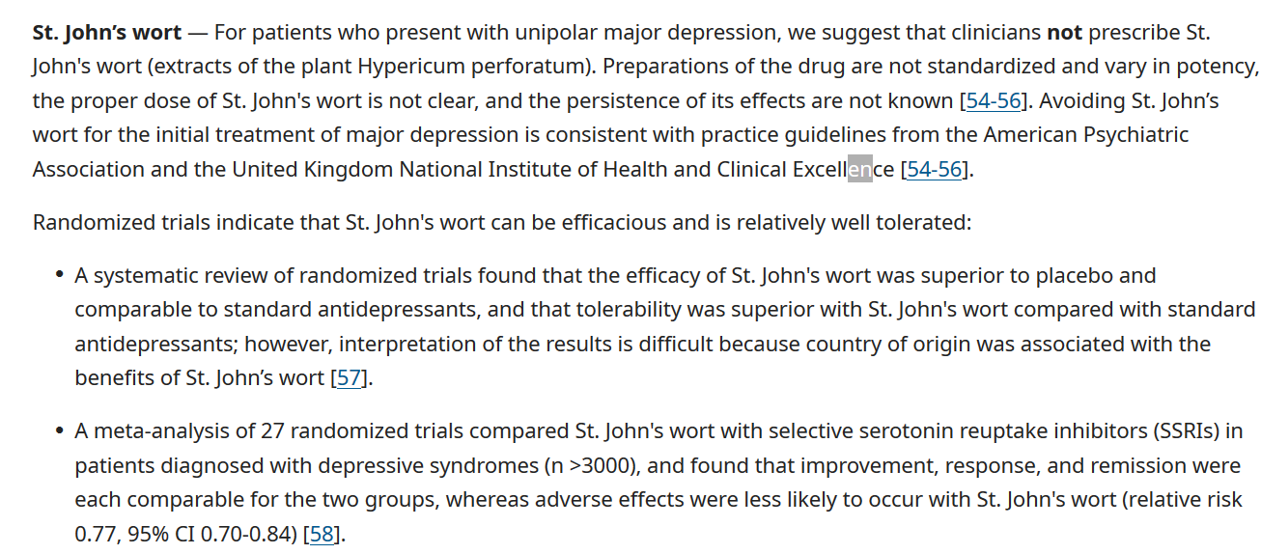

Slide 53
...clinical use of St. John’s Wort

Slide 54
Time to consult “experts”

Slide 55
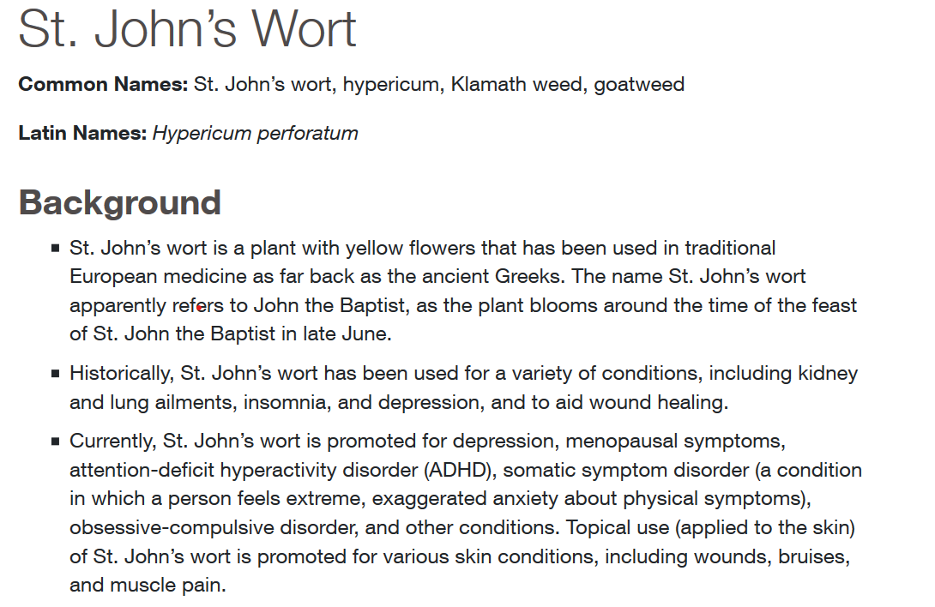

Slide 56
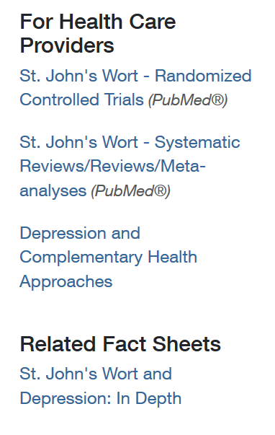

Slide 57
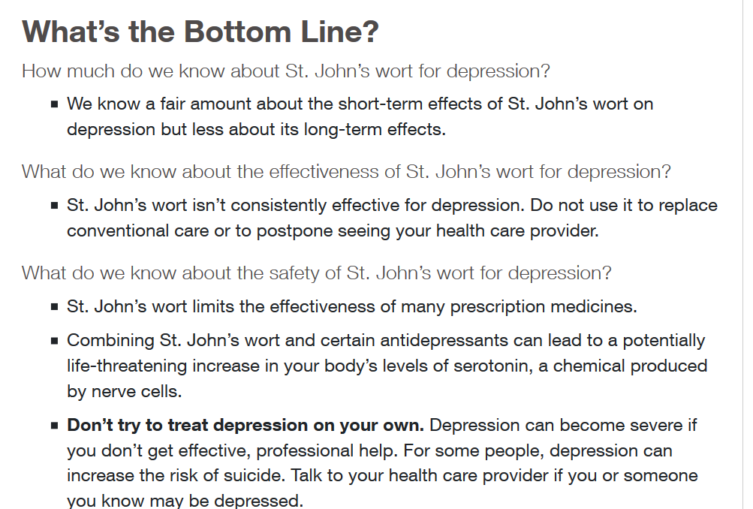

Slide 58
Other Government “Expert” Sources
US Food and Drug Administration (FDA)
NIH Office of Dietary Supplements (ODS)
Dietary Supplement Fact Sheets
Dietary Supplements: What you Need to Know
Evidence-Based Reviews
Federal Trade Commission (FTC)
NIH - Know the Science
Drug-supplement interactions
Placebo effect
Myths about “natural” products
MedlinePlus.gov

Slide 59
FDA Warnings
Remember Wormwood?
Warning Letter – May 25, 2017 to The Herbalist, Inc.
“The claims on your website establish that the products are drugs under section 201(g)(1)(B) of the Act [21 U.S.C. § 321(g)(1)(B)] because they are intended for use in the cure, mitigation, treatment, or prevention of disease.
As explained further below, introducing or delivering these products for introduction into interstate commerce for such uses violates the Act. You can find the Act and FDA regulations through links on FDA’s home page at www.fda.gov.”
Wormwood Capsules:
“[W]orm-wood” is used to cleanse the body of worms and other parasitic invaders…It is a powerful anti-parasitic agent that is effective at killing both mature parasites as well as their larvae.”

Slide 60
Questions to consider
Is there a likelihood CAIM will result in toxic or adverse effects?
Is it affordable?
Is there any data from RCTs or outcomes research?
Do these studies meet quality criteria?
Is there sufficient product quality or qualified practitioner?

Slide 61
Takeaways
CAIM presents unique “evidence” challenge and considerations
EBM framework should be used, when possible, to find evidence for CAIM
Often it is necessary to consult “experts”
Not all evidence is created equal

Slide 62
Thank you!

